Slide 1
Notes:
Kayla

Slide 2
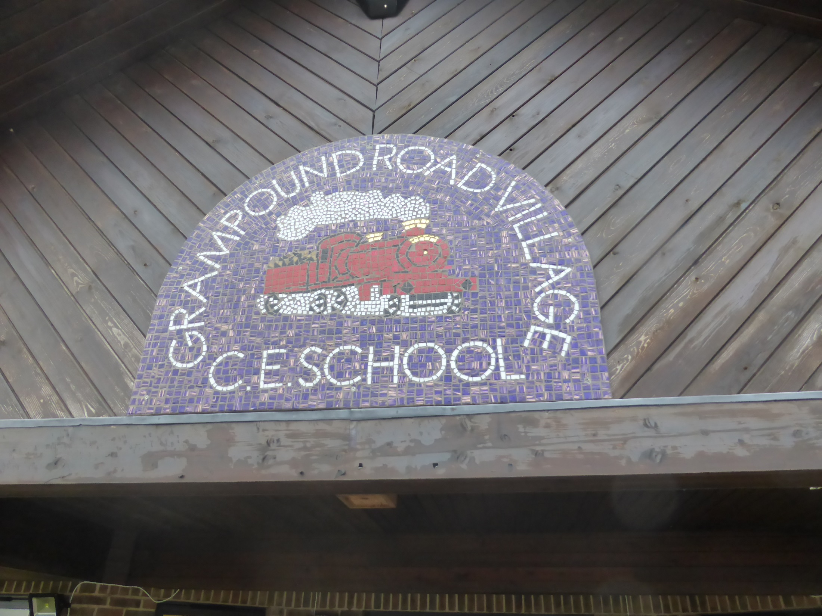
Grampound Road - behind the scenes.
By the school councillors of Grampound Road School (a part of The St Pirans Cross MAT).
Notes:
Oscar

Slide 3
We love to learn!
In Grampound road school, we have the most professional teachers in Cornwall (in our opinion).
We have ‘learning walls’ all over the school.
We have 5 classes in the school: Carne (the receptions); Godrevey (Year 1 and 2 ); Pendower (Year 2 and 3); Fistral (Year 4 and 5); and Holywell (Year 5 and 6).
Notes:
Ryan

Slide 4
The School Teachers…
Meet the staff!
Mr Keast and Mr Ayres keep us fit and healthy!
Mr Cornish always makes learning fun!
Miss Cameron is the head mistress and makes sure everyone is happy.
Mr Moore teaches Fistral and enjoys football too.
Miss Kennedy looks after the little ones (Foundation stage).
Miss Peters takes care of Godrevy.
Miss Eastham teaches Year 2 and 3
Mrs Black, Mrs Warne, Mrs Moore and Miss O'Shaughnessy are the teaching assistants.
Notes:
Halle

Slide 5
We are very lucky!
We are a C of E church school.
We have a nature tower.
We have just won a Tesco grant.
We have fun teachers.
Everyone is HAPPY.
Notes:
Jack

Slide 6
School Values…
Wisdom.
Respect.
Perseverance.
Forgiveness.
Compassion.
Trust.
Notes:
Heidi

Slide 7
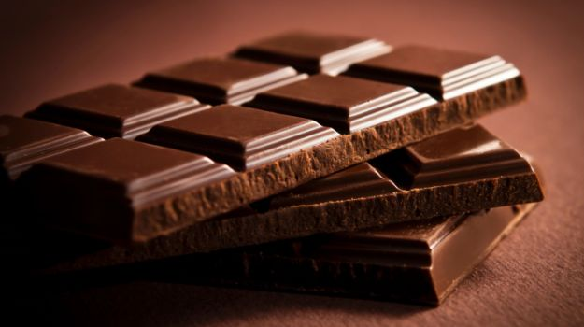
SCHOOL TOPICS…
Chocolate
India
Survival
Fairy Tales
Jungle
Notes:
Sam and Ella

Slide 8
Our Library…
Notes:
Leo

Slide 9
We don’t tolerate bullying…
Notes:
Wilf

Slide 10
The Character Project…
Notes:
Ryan

Slide 11
The school council is key…
Notes:
Erin

Slide 12
Reflecting is an important part of learning…
Notes:
Halle

Slide 13
Notes:
Kayla

